Slide 1

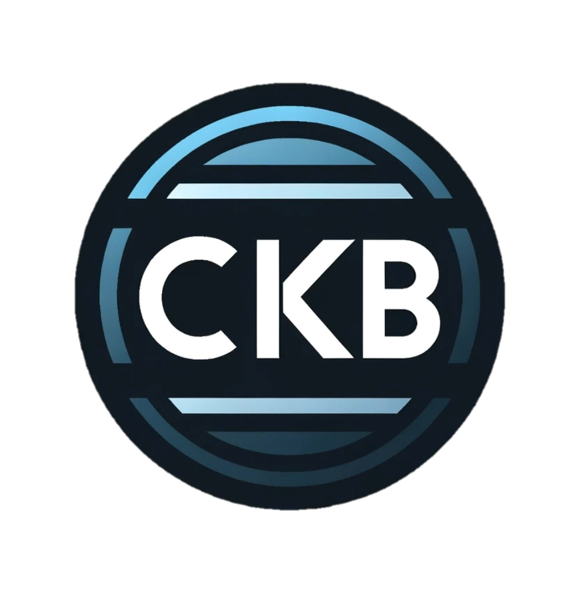
Software Engineering 2
Code Kata Battle
A.Valica, R.Tiwari, P.Garcia
Notes:
Hello everyone, welcome to the Software Engineering 2 project presentation on the topic code kata battle

Slide 2
Project Summary
Introduction
Scope and Requirements
Overview of the system's architecture
User Interface Design
Formal Analysis of ALLOY 6.0
Implementation and Testing Strategy
Conclusion
Bibliography
A.Valica, R.Tiwari, P.Garcia
Notes:
In this project we will cover the following aspects that include the a brief introduction of our project, the scope and requirements of the code kata battle.
We also cover the entire system's architecture and give the idea on how our User Interface looks like. Giving the idea about the formal analysis of the alloy, we will cover the implementation and testing strategies followed by conclusion.

Slide 3

Introduction
A.Valica, R.Tiwari, P.Garcia

Slide 4
Introduction
What is Code Kata Battle?
Educational website to learn how to code and improve coding skills through a lot of exercises.
What is the project purpose?
Make education a more fun experience without reducing quality.
Which are similar systems?
CodeWars.
A.Valica, R.Tiwari, P.Garcia

Slide 5

Scope and Requirements
A.Valica, R.Tiwari, P.Garcia

Slide 6
Project Scope
Who is the target audience?
Educators
Students
What devices should it be available on?
Completely usable on desktop devices, through browsers.
Browsable using any device, such as phones and tablets.
What is the functional scope?
Defines broad range of functionalities CKB offers
Emphasises on interactive learning experience for developers.
Fosters dynamic learning experience through competition, collaboration and personal growth.
A.Valica, R.Tiwari, P.Garcia
Notes:
The target audience:
- the educators that use the platform to host competitions for their classes, either as grades for the course, or as a complementary learning method for students
- the students that use it to train and exercise in software development, and can attend the challenges set by their teachers.
Concerning the devices it will be available on, CKB will be browsable on any device, allowing users to check the challenges and their status. However the full functionalities, concerning creating, joing and taking part into tournaments and battle will only be available on Desktop.
Functionally, the project emphasises on the interactive and dynamic learning experience that can be reached through competitive battles and exercises, leading to the students’ growth.

Slide 7
Requirements
Authentication services – Login and Registration
Creating and taking part in tournaments and battles.
Grading of the submission and displaying the scores.
Recognition in terms of badges ensuring motivation and consistency.
Creating and joining groups of students.
Notifying users regarding updates and tournaments whenever needed.
A.Valica, R.Tiwari, P.Garcia
Notes:
While taking into account the scope, we identified the following requirements. The categories are the following:
- Providing an authentications ervice, supporting both of the user types
- Allowing the users to create and take part into tournaments and battles
- Having the system able to grade the submissions autonomously, or with the implication of the educators on demand,
- Gamify the student progressions, by creating and awarding badges
- Letting the user subscribe to some events and get notified on time.

Slide 8
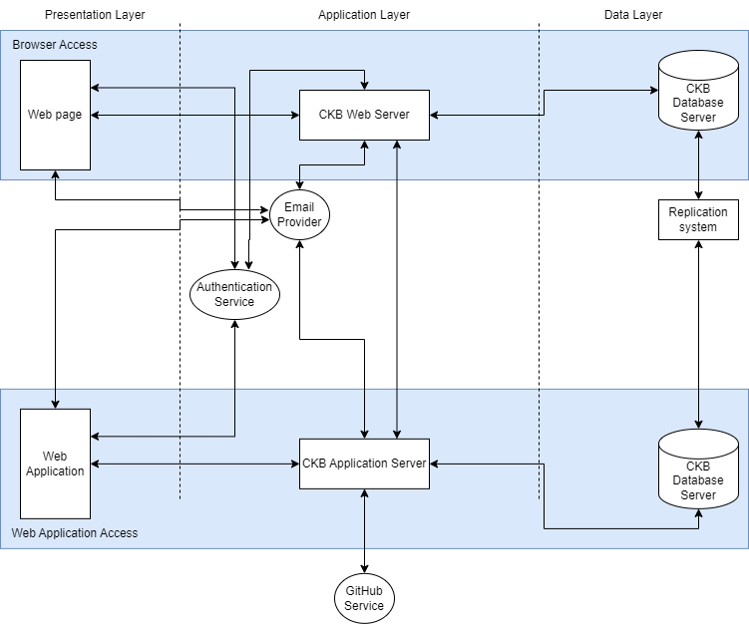
CKB Architecture
A.Valica, R.Tiwari, P.Garcia
Notes:
Now that we have the scope and required elements for the project clear in mind, we can discuss about how this project will be articulated.

Slide 9
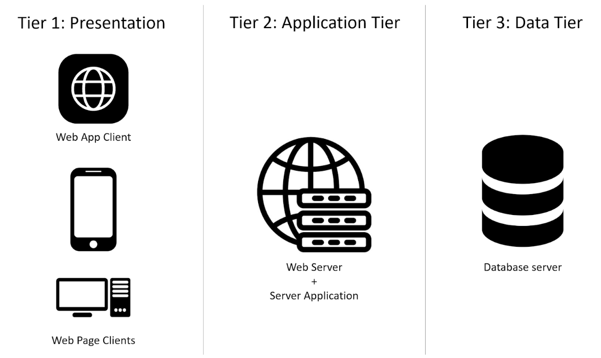
Architecture: High-level view
Three-Tier Architecture:
Architecture clearly divided in three layers:
Presentation layer: web page (all devices) and web app
Application layer: web and logic servers
Data layer: accounts, battles...
Dual-Path Architecture:
The architecture uses a different subset of components depending on the current task of the user:
Browsing usecase: the Web page, Web Server, Database Server.
Functional usecase: the Web Application, Application Server, Database Server.
Design principles applied:
Separation of concerns, reusability, low coupling, scalability and flexibility, efficiency.
A.Valica, R.Tiwari, P.Garcia
Notes:
We decided that the most well suited architecture type for this system would be a Three Tier Architecture, with the usual three layers.
- The presentation layer would be made out of the web application and the web pages
- The Application layer would be made of the web and logic servers, taking care of all the the business logic action requested by the presentation layer
- The Data Layer: that would be storing all the information regarding the accounts, the tournaments, battles, scores, badges and groups.
On top of that we decided to split the system in two functioning paths for different use cases:
- A browsing use case, using the web page and the web server mainly. This will be used by users to browse through the platform, subscribe to events and check notifications, and will have lower performance resources required.
An active working use case, using the web app and the application server mainly. This will be used for important work such as creating a tournament or battle, or running tests on submissions.

Slide 10
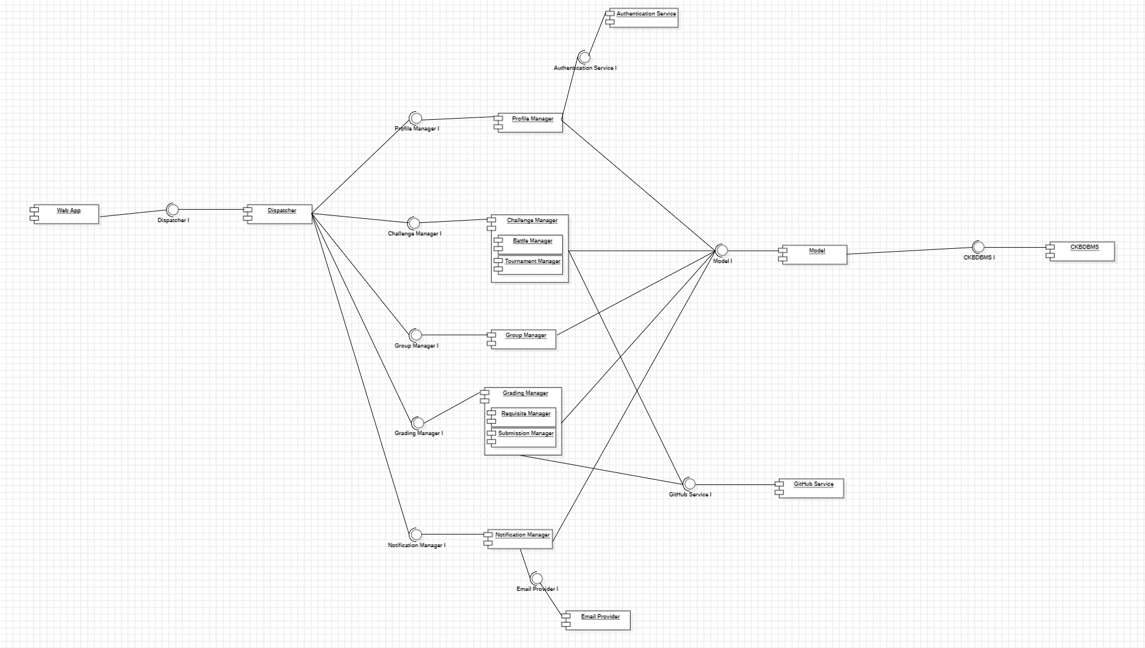
Architecture: Components
Components Hierarchy:
External Services
Different levels for components:
User visible components
The Dispatcher
Logic Components
Model and Databases
Authentication Service
GitHub Management Service
Mail Provider Service
Mediator Pattern
Model View Controller
Facade Pattern
Managers for every logic component.
View: Visible components
Controller: Logic components
Model: Model + Databases
Dispatcher is the only accessible component from the User interface components.
Results
Low coupling, Flexibility and Scalability, Simple Interfaces, Encapsulation, Separation of Concerns.
A.Valica, R.Tiwari, P.Garcia

Slide 11
A.Valica, R.Tiwari, P.Garcia

Slide 12
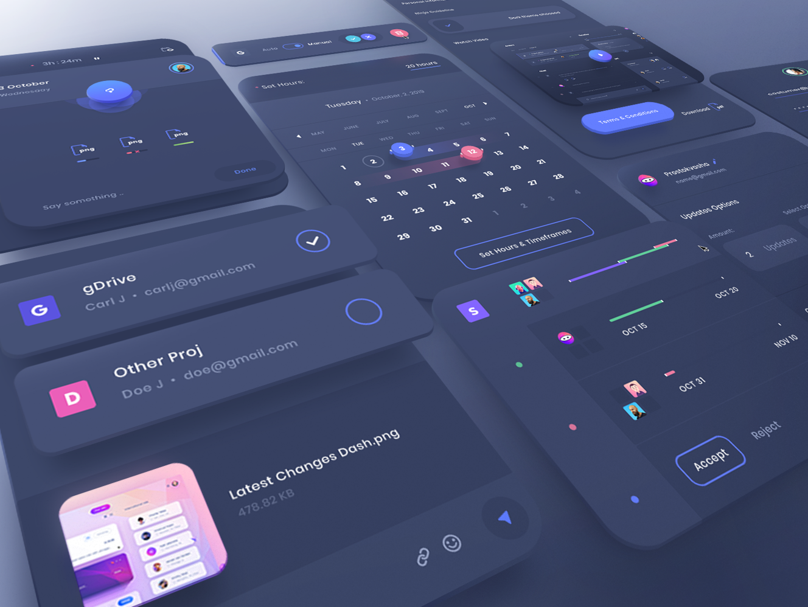
UI Design
A.Valica, R.Tiwari, P.Garcia

Slide 13
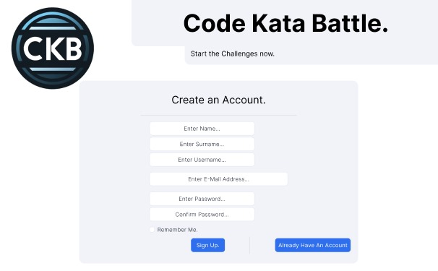
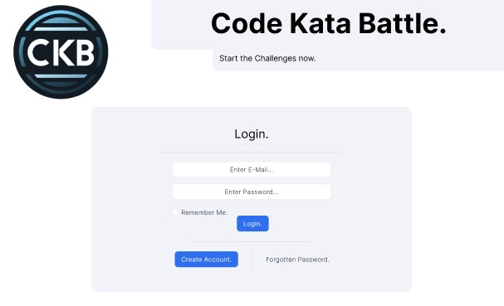
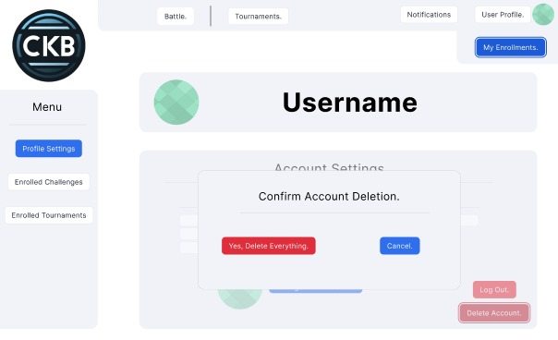
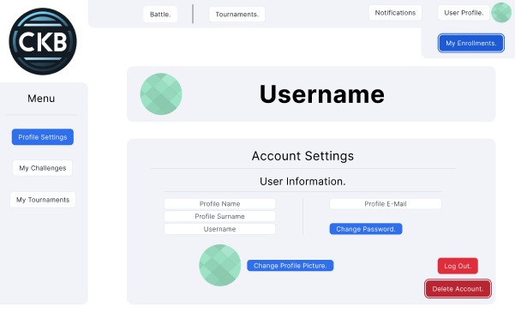
User Interface: Profiles
A.Valica, R.Tiwari, P.Garcia
Notes:
Creation of account, login after creation, deletion of account and account settings

Slide 14
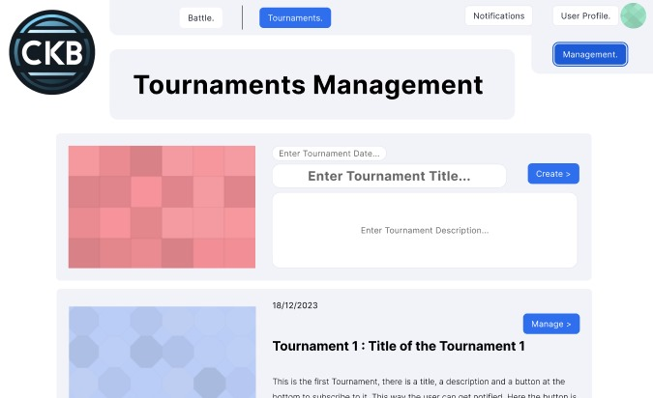
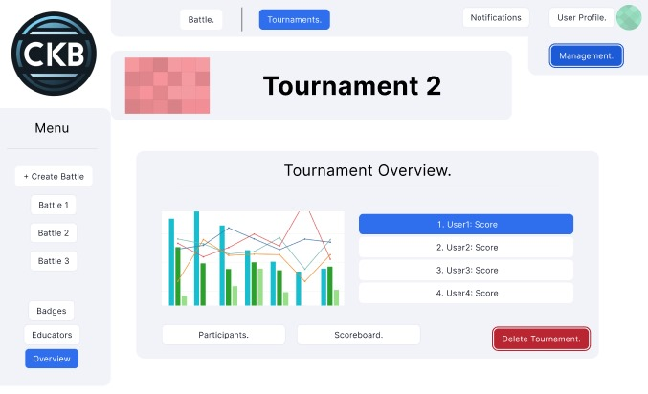
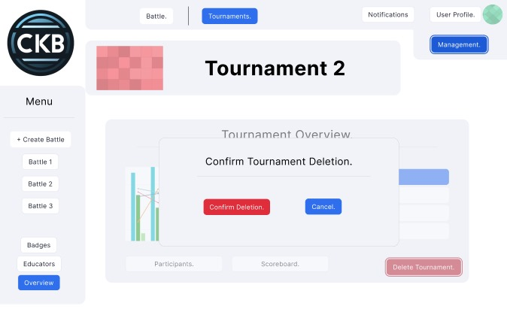
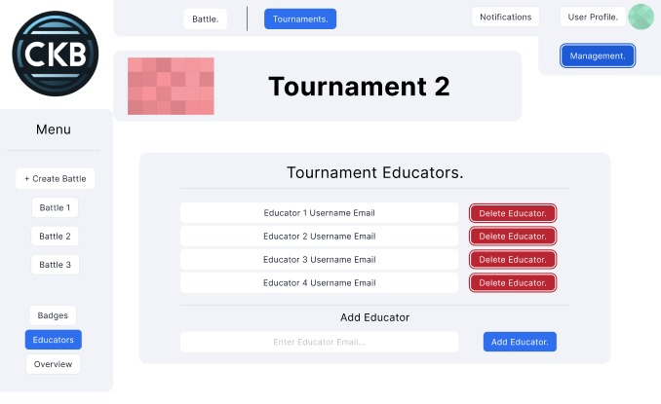
User Interface: Tournaments
A.Valica, R.Tiwari, P.Garcia
Notes:
This is for the educators where they can create and delete battles. They can also create multiple tournaments and add educators. They can also check the user scores in a graphical version as well for comparison

Slide 15
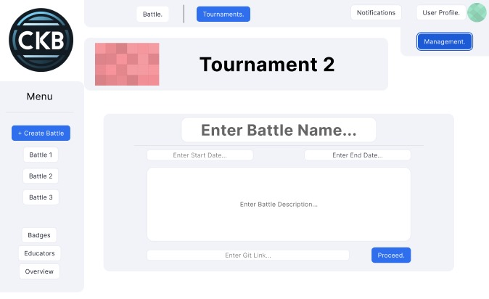
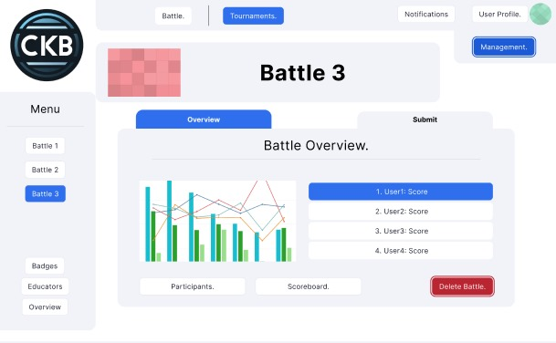
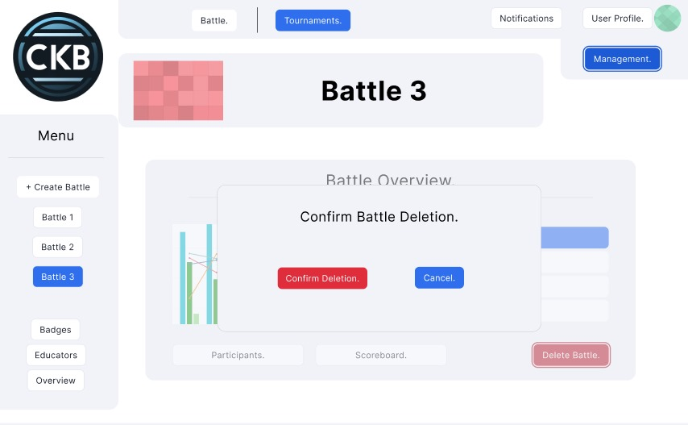
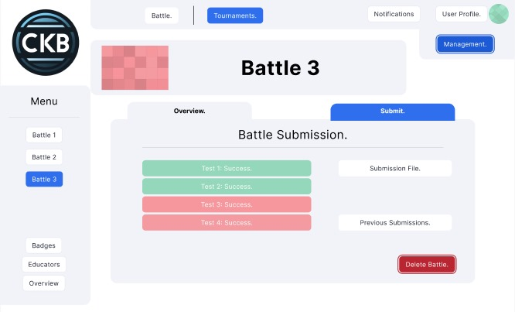
User Interface: Battles
A.Valica, R.Tiwari, P.Garcia
Notes:
Here the educator can create battles and students can join them. The battle overview can also be seen by the educators and they can also delete it.

Slide 16
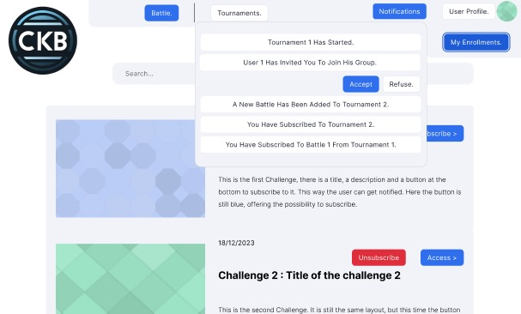
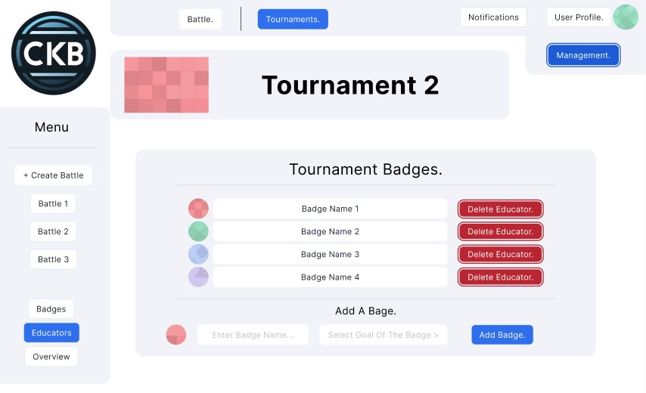
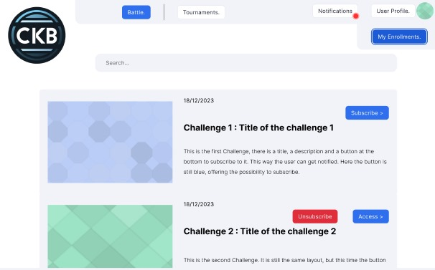
User Interface:
Notifications + Search + Badges
A.Valica, R.Tiwari, P.Garcia
Notes:
In this UI, a student and educator both can receive notifications from the groups/tournaments and they can also search for challenges. They can also see if they have received any badge for their performance in the tournament badges window.

Slide 17
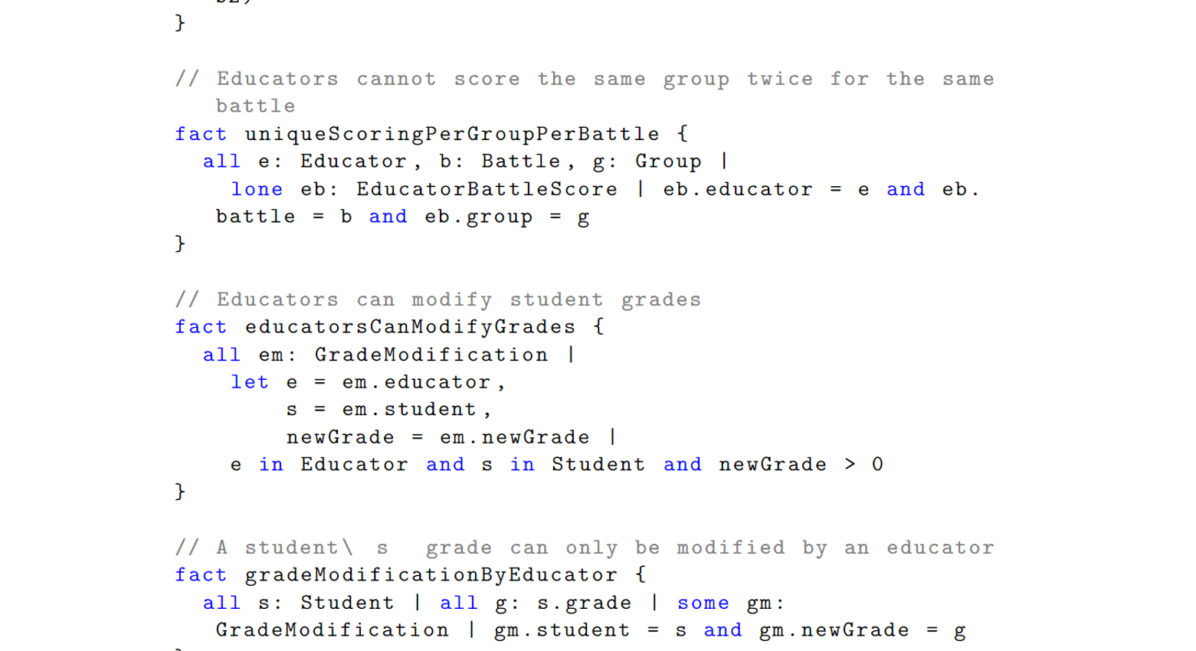
Formal Analysis Alloy
A.Valica, R.Tiwari, P.Garcia

Slide 18
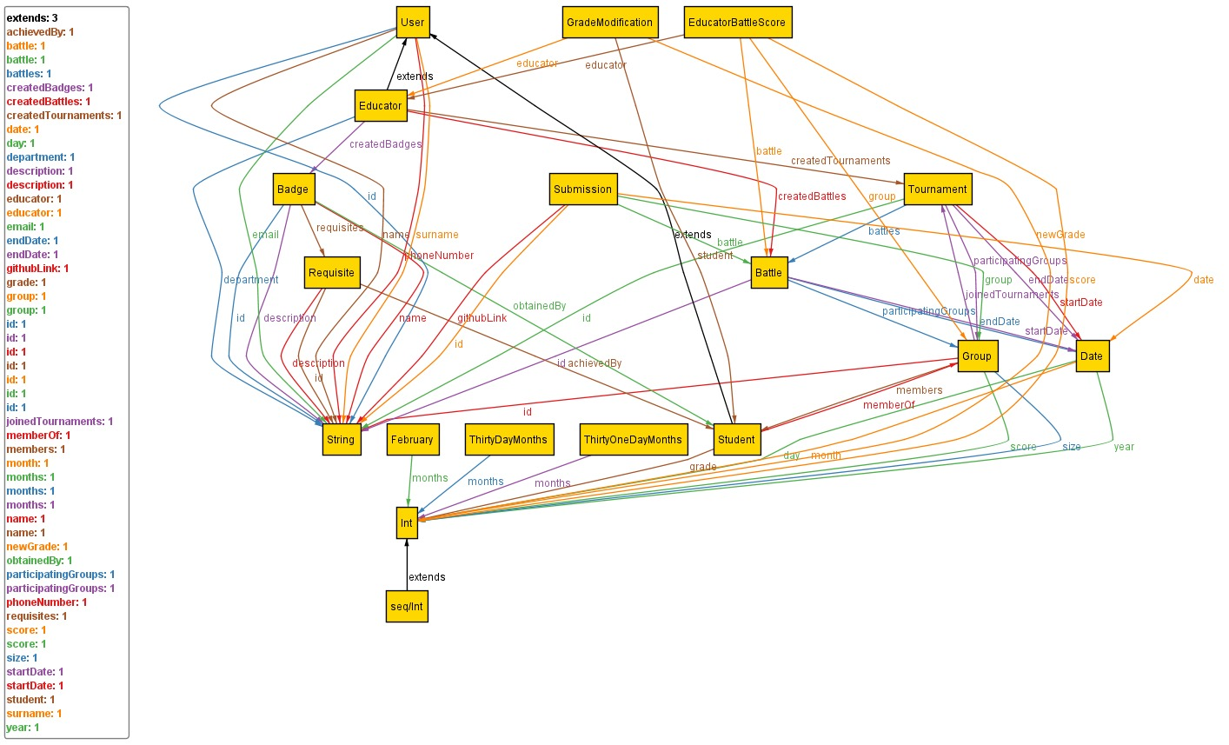
Formal Analysis Alloy
A.Valica, R.Tiwari, P.Garcia
Notes:
this is a model visualization generated by Alloy, a formal modeling tool used in software design.
Depicted in yellow rectangles are signatures such as badge, educator, user, grade modification etc.
Arrows with an unfilled triangular head represent inheritance relationships
The lines connecting the signatures represent relationships or fields. For example, the line from `Educator` to `createdTournaments` indicates that `Educator` has a relationship to one or more `Tournament` instances.
The labels on the lines indicate the cardinality of the relationships. For example, `1` means one-to-one, `some` indicates a one-to-many relationship
The signatures `ThirtyOneDayMonths`, `ThirtyDayMonths`, and `February` likely represent constants that are used to enforce date-related constraints, such as the number of days in a month.

Slide 19
Formal Analysis Alloy
Users of the system: Entities differentiating between Educators and Students.
Challenges system: Entities supporting creation for Tournament and Battle systems.
Gamification system: Entities supporting creation and attribution of Badges.
Grading system: Entities supporting submissions and gradings
Grouping System: Entities supporting creating and joining groups
Utility entities: Entities such as Date, Month, String…
A.Valica, R.Tiwari, P.Garcia
Notes:
User Roles: The system differentiates between two main user roles: Educator and Student. Each has unique attributes and roles within the system.
Group Management: Students can form groups, which are integral for participating in tournaments and battles. Each group has a defined size and score.
Competitions: The system organizes coding competitions in the form of Tournaments and Battles. Tournaments consist of multiple battles, and groups can join these tournaments.
Submissions and Scoring: Submissions are made for battles with specific details like GitHub links. Educators can score these submissions.
Badges and Requisites: Students can earn badges, which have specific requisites. A badge is awarded when a student meets all its requisites.
Scheduling: Dates are meticulously tracked to manage the scheduling of tournaments and battles, ensuring no overlaps.
Unique Constraints: The system enforces uniqueness in various aspects, like tournament names, and prevents overlapping group memberships and battle participations.
Educator Actions: Educators can create tournaments, battles, and badges, and have the ability to modify student grades.
Fact Constraints: Various facts ensure logical consistency, such as ensuring group sizes match member counts, submissions align with battles, and badge requisites are met.
Validation and Restrictions: The system includes predicates and facts to prevent overlapping battles, ensure unique submissions per group per battle, and manage badge awards and educator scoring.

Slide 20
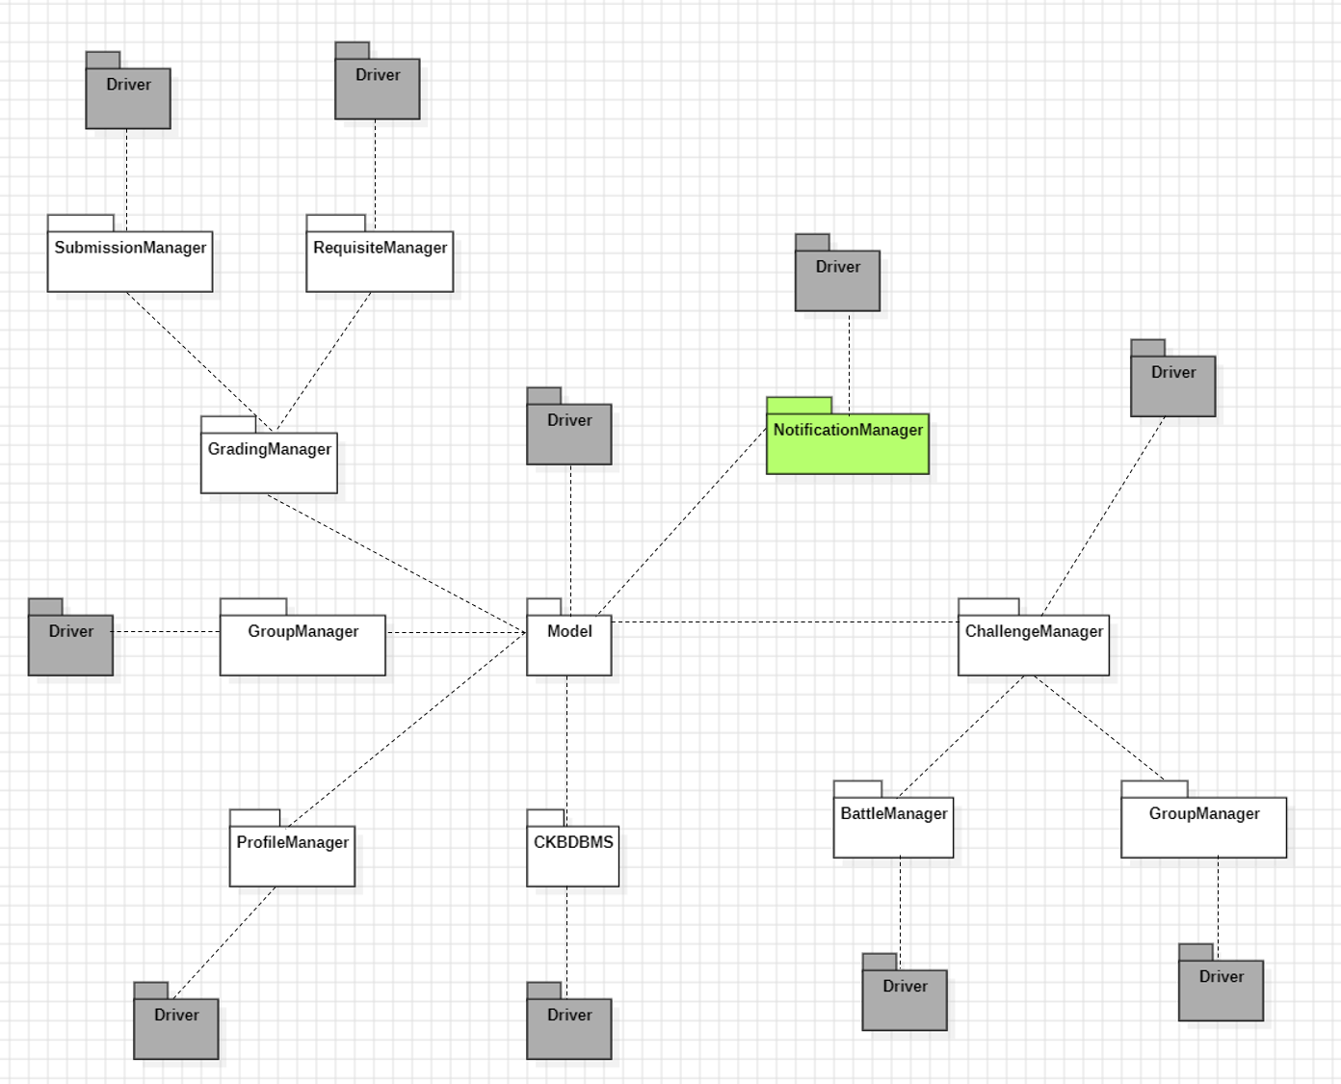
Implementation
and Testing
A.Valica, R.Tiwari, P.Garcia

Slide 21
Implementation: Choices
Top Down approach
For efficient implementation and easy bug tracking.
Feature identification
The most important functionalities of CKB. They concern:
Account management and creation
Creation and management of tournaments and battles
Joining tournaments and battles
Grading submissions and managing badges
Making Groups of students
Managing the notifications
Thread based approach
For stakeholder demonstration, and early modifications on the system.
Implementation Flows
Order of implementation to conceal structurally efficient approaches and demonstrative versions of the features identified.
A.Valica, R.Tiwari, P.Garcia
Notes:
Now I am going to talk about the implementation and testing part of our project. When it came to implementation, several choices had to be made. Since there is not an absolute answer we thought about several approaches. In the first place, and for the integration testing strategies we thought that the hierarchical top down approach making use of stubs of used modules was our best alternative. We thought that more functionality could be tested in this manner. Besides, we used a thread based approach. Why is that? Because in case we were to work with stakeholders we believe that always having a functional (although maybe not complete) version was fundamental to have better communication. On the right side we see the different functionalities of the system perfectly defined for the sake of modularity since our implementation flow would follow that order.

Slide 22
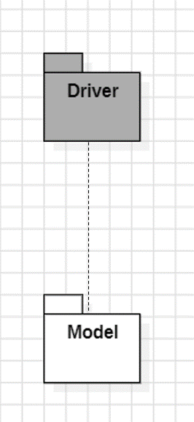
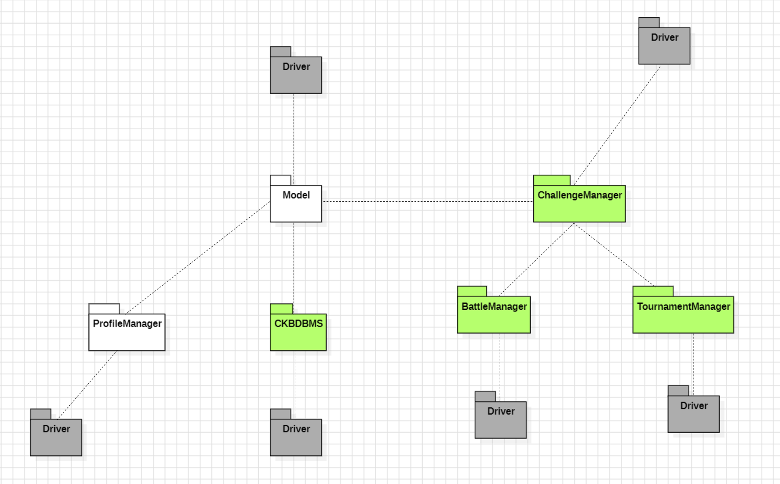
Implementation and Testing: Plan
Starting with a core component used in every thread: Model.
Then implement the other core components together with their used components, according to the threads.
Repeat until everything component is present and tested.
Incremental Integration and Testing:
Multiple Testing Styles:
Unit testing per component,
Integration to the thread group,
First Integration testing,
Integration of the thread and second integration testing.
Functional Testing,
Performance Testing,
Usability Testing,
Load and Stress Testing...
A.Valica, R.Tiwari, P.Garcia
Notes:
It is key to test the system throughout the whole project as leaving testing for the final phases is a big mistake that could exponentially increase bugs.
To implement everything we have to start with a core component called Model which is used in every thread and then progressively add core components together with their used components according to the threads until all components are implemented. We must not only test that the system works logically but also that it is intuitive to use, that its performance is decent and so on and so forth.

Slide 23

Conclusion
A.Valica, R.Tiwari, P.Garcia

Slide 24
Conclusion
What problems did we face?
Time issues since we all had different schedules.
Learning the technologies for building the project.
What could be improved?
Scope of the project, adding more functionalities for multiple platforms.
Anti-cheat detection system for exercises and competitions.
Enlarge the user scope to companies.
What have we learned?
Following a SCRUM process.
Collaborative learning, research and development.
A.Valica, R.Tiwari, P.Garcia
Notes:
So now that we explained our project we can extract some ideas:
Some of the problems that we faced were time issues as we did have different courses and hence time schedules.
We also needed to spend some time learning the technologies we used for making the artifacts like FIGMA or Alloy 6.0 that we had not used before.
Something that could be improved is the scope of the project, making it a bit more ambicious by for instance adding more functionalities like inter platform support. Another good idea could be making italso an useful system for company developers or design and anti-cheat detection system for exercises and competitions.
Finally I would like to talk about what we have learned. Just to name a few things: Following a SCRUM process and having a collaborative learning, research and development where although we did not do everything, we knew and were aware of what others had done and how did they do it and most importantly how did it work and how to understand it.

Slide 25
Bibliography
Alloy tools. https://alloytools.org/download.html
Codekata main page. http://codekata.com/
Example of a similar site (codewars). https://www.codewars.com/.
What is test-driven development (tdd)? https://en.wikipedia.org/wiki/Test-driven_development/
Visual Paradigm. What is a sequence diagram? https://www.visual-paradigm.com/guide/uml-unified-modeling-language/what-is-sequence-diagram/
Draw.io. https://www.draw.io/ High level architectures are made using draw.io
Staruml. http://staruml.io/ Testing models and component architecture made with StarUML
Politecnico di Milano. Software Engineering 2 course material (academic year 2022-2023)
A.Valica, R.Tiwari, P.Garcia
Notes:
Here is the bibliography in case you need to check something.

Slide 26

Any Questions?
A.Valica, R.Tiwari, P.Garcia

